Slide 1

SOCIAL MEDIA IS THE BEST PLATFORM FOR BUSINESS
Presented by:
Muhamad Hibatul Wafee
(2020970537)

Slide 2
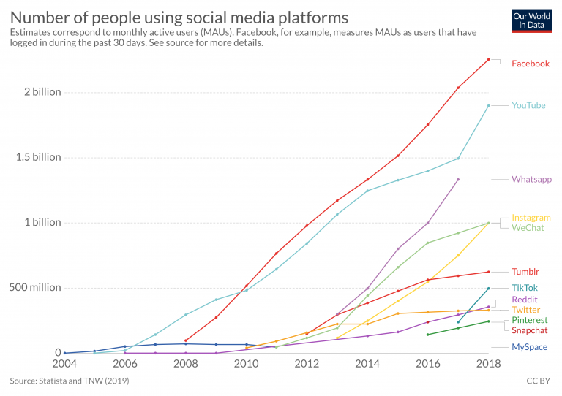

Slide 3
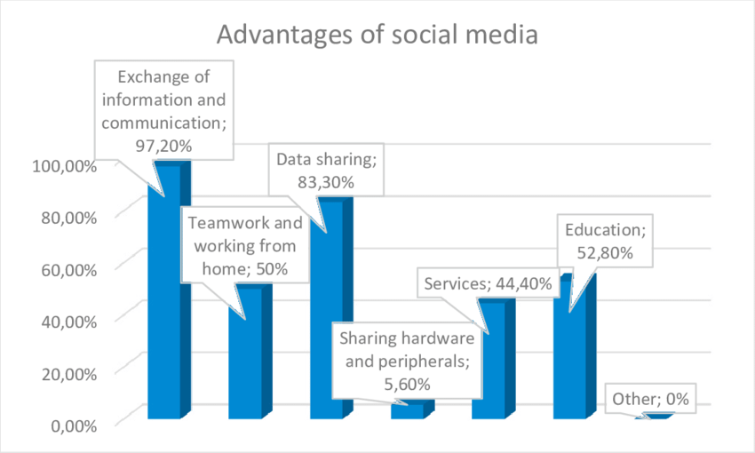

Slide 4
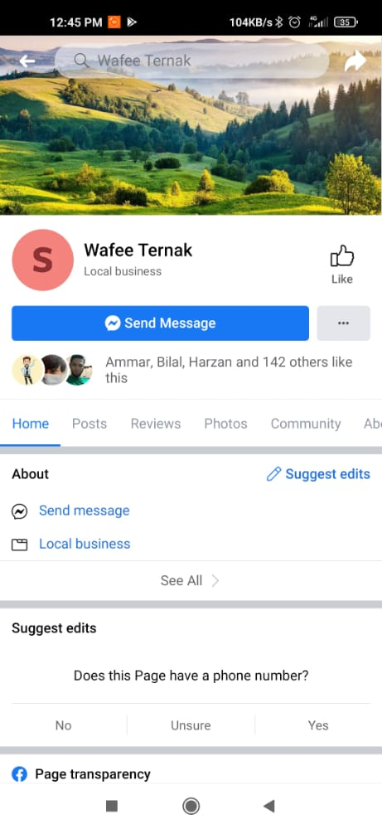
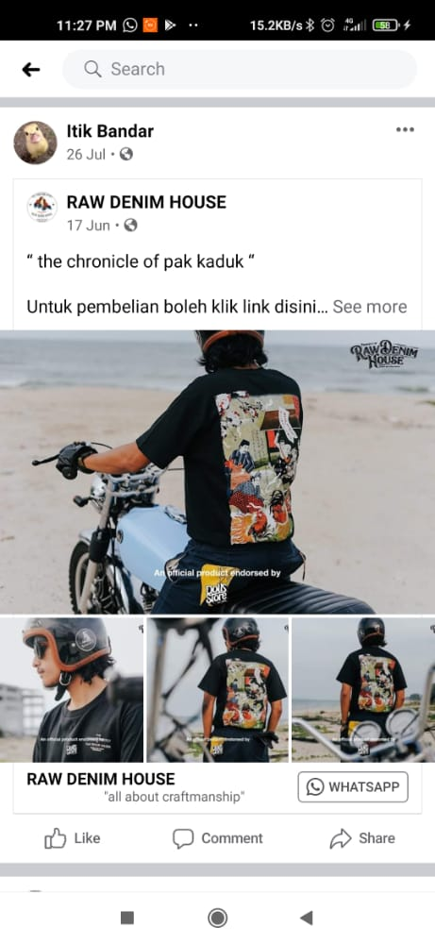
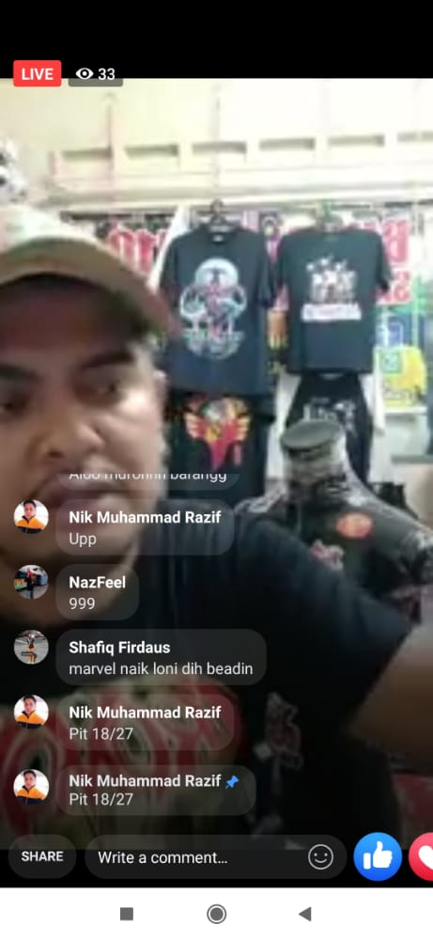

Slide 5


